Slide 1
Temporal Convoluted Network based Encoder Decoder architecture for Remaining Useful Life Estimation for Turbo fan Engine
Project : FlexKI
By : Souptik Sen

Slide 2
Content:
Problem Statement
Dataset
Data Preprocessing
Data Processing
Proposed Model Architecture
Individual Layers
Metrics
Results

Slide 3
Problem Statement
The provided dataset comprises multiple multivariate time series data representing a fleet of engines, each with varying degrees of initial wear and manufacturing variations. These variations, along with sensor noise, are typical and not indicative of faults. The dataset includes three operational settings that significantly impact engine performance, along with sensor measurements from each engine over time.
The engines operate normally at the beginning of each time series and begin to degrade as the series progresses. The challenge is to predict the remaining useful life (RUL), defined as the number of remaining operational cycles before reaching the critical threshold in the test data, using the provided engine sensor and operational data.

Slide 4
Dataset
The dataset contains sensor measurements and operational settings from engines in a fleet, where each engine represents an individual unit. The features can be categorized as follows:
Operational Settings: Three specific operational parameters that significantly affect engine performance. These settings likely represent human controllable input factors such as temperature, pressure, or throttle settings, which are critical to engine operations.
Sensor Measurements: A set of 21 sensor readings that capture various aspects of engine health and performance. These sensors may measure temperature, pressure, speed, vibration, and other physical quantities that reflect the engine's condition.
RUL Generation: The Remaining Useful Life (RUL) is derived for each engine unit based on its operational cycles. The RUL represents the number of cycles left before an engine reaches its failure threshold i.e the engine series ends. In the context of predictive maintenance, the RUL is a critical metric, as it helps in scheduling maintenance, repairs, or replacements before an engine fails, thus avoiding unscheduled downtimes and potentially catastrophic failures. The challenge lies in accurately predicting RUL by analyzing the pattern of degradation through sensor data and operational settings, taking into account the inherent noise and variability in the data.

Slide 5
Data Preprocessing
The Data Preprocessing for this project can be split up into the following parts :
Feature Selection/ Reduction using Random Forest Regressor
Filtering of Sensor Measurements
RUL Label generation

Slide 6
Data Processing
Feature Selection using Random Forests
A random forest regressor is trained on the dataset to understand the importance of every feature for predicting the RUL data. The dataset is split into features (X) and the target variable (y). The RUL column is the target variable, which the model aims to predict.
Random Forest is an ensemble learning method that builds multiple decision trees during training and outputs the mean prediction of the trees for regression tasks (or the mode of their predictions for classification). It is robust against overfitting as it averages the results of individual trees, which may themselves overfit the data. The trees in the forest are constructed in a way that reduces correlation between individual trees—each tree is trained on a random subset of the data (bagging) and considers a random subset of features when making splits.
The Random Forest algorithm provides an estimate of feature importance, which indicates the relative importance of each feature in predicting the target variable. These importances are converted into a pandas Series, indexed by the feature names, and then sorted in descending order. This helps to identify which features are most influential in predicting RUL and thus we can remove features with importance scores less than a particular threshold.

Slide 7
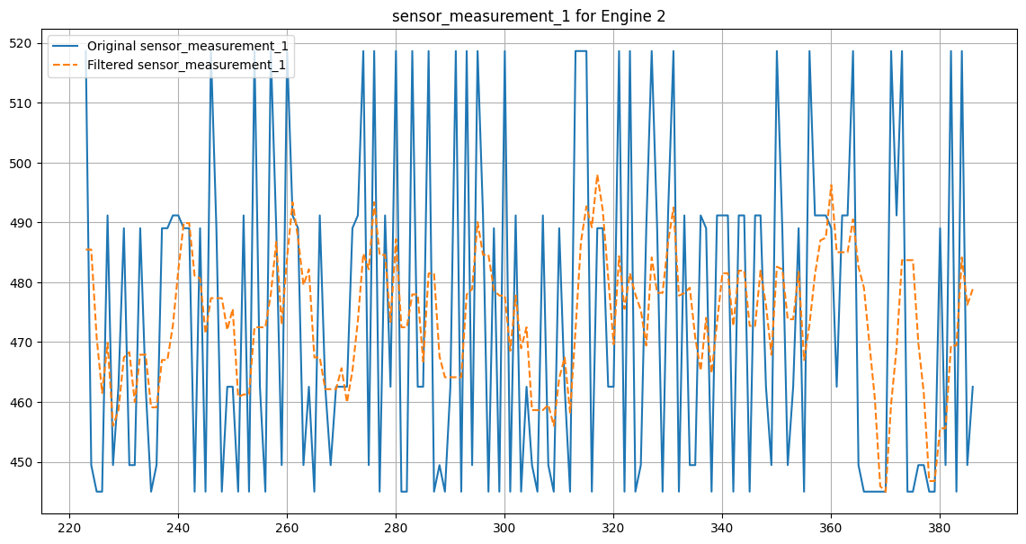
Data Processing
Filtering of Sensor Measurements
The sensor measurements in our dataset have a high frequency noise which distorts the measurements at every time cycle for every engine unit. A moving average filter was used to filter sensor measurements.
The plot displays the original and MA filtered sensor measurement 2 for Engine 1, with the filter smoothing out high-frequency noise to reveal the underlying trend of the sensor data.

Slide 8
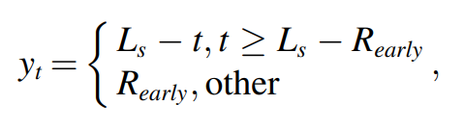
RUL Label Generation
In practical applications, when a new aero-engine is put into service, performance of the aero-engine is stable and degradation of the aeroengine is slight in its initial stage. When a failure occurs, the aero-engine’s RUL decreases with increasing service time. Therefore, a piecewise linear function was adopted to set RUL label.
The RUL label is set with the above formula, where t represents time step. Ls represents the RUL at initial moment of an engine and Rearly represents the maximum RUL value. The Rearly for this experiment has been set to 125 time-cycles.

Slide 9
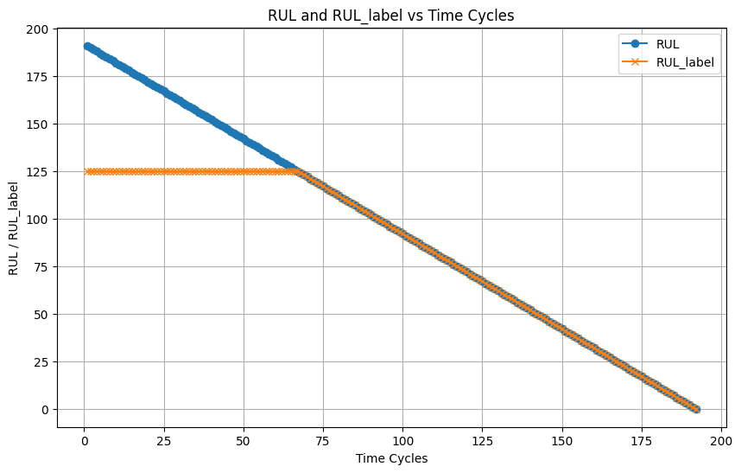
RUL Label

Slide 10
Data processing
Data Processing consists of the following steps:
The dataset is split into training, testing and validation datasets.
The separate datasets are scaled and normalized separately to avoid any kind of overfitting or data anomalies.
The datasets are then windowed temporally by using a sliding window operator function to generate input and target sequences for our model.

Slide 11
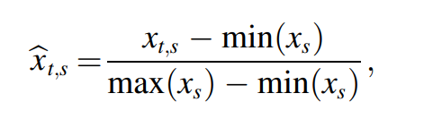
Normalization of Sensor Data
Different sensors are used to obtain monitoring signals with different amplitude ranges. Each sensor corresponds to a channel, and monitoring signals collected by multiple sensors constitute multi-channel data. In order to make different channel data comparable, it is essential to normalize all data. Min-Max normalization, i.e. linear normalization, is adopted to scale sensor data of each channel to range [0,1] as follows.
where ̂xt,s represents normalized data for the s-th (s = 1,2, …,S) sensor at the t-th time step. max(xs) and min(xs) denote the maximum and minimum values of the s-th sensor data, respectively.

Slide 12
Sliding Window to generate Sequences
Since the lengths of data from different sensors might be different, a sliding time window is used to process feature samples, so as to ensure that all features input are of the same size. A feature sample, which starts at time step t and ends at time step t+W-1, is intercepted from the multi-channel data through a fixed window size W.
Corresponding RUL label is yt+W-1. The fixed window size W is slid in increasing time step direction. Each sliding step is set as l. Meanwhile, multi-channel data is split into several samples to generate the training and testing sample sets and the corresponding RUL label sets.

Slide 13
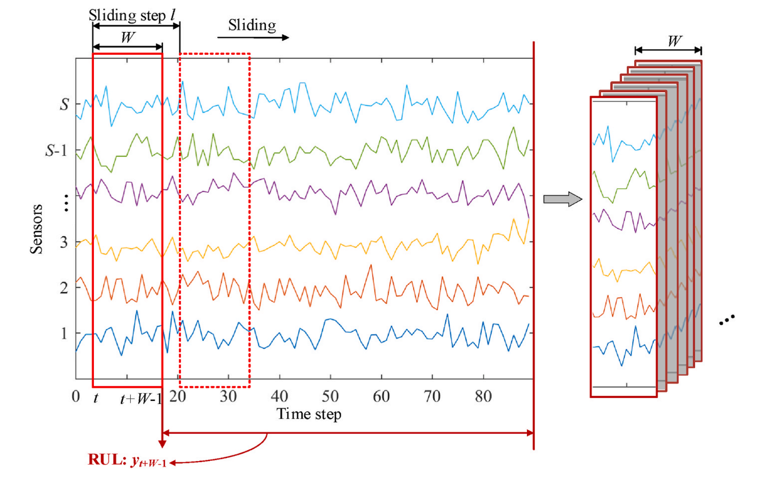
Sliding Window

Slide 14
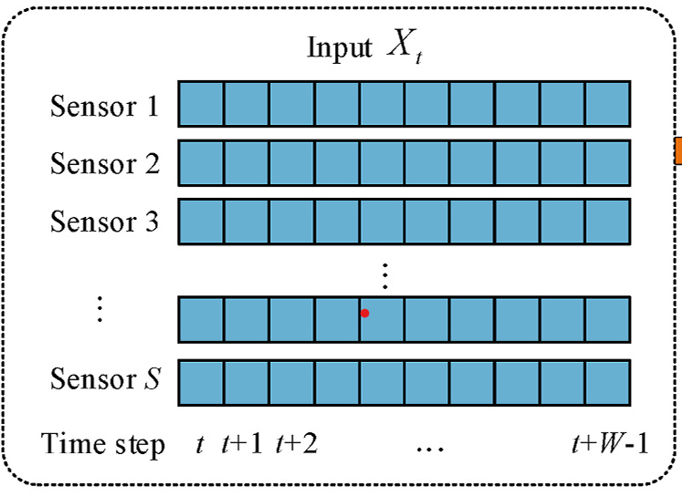
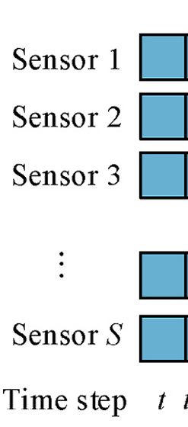
Different Sequences
The following sequences were created for encoder and decoder based on 2 hyperparameters, input sequence length (window size) and output sequence length(window size) .
X_Encoder : The input for the Encoder. Has the feature variables, i.e sensor measurements for the number of time steps specified by input sequence length, which is 15 for our experiment.
X_Decoder: The input for the Decoder. Has the feature variables i.e sensor measurements for the number of time steps specified by output sequence length or target sequence length, which is 1 for our use case i.e. the timestep for which we are predicting the RUL.
X_Encoder
X_Decoder

Slide 15
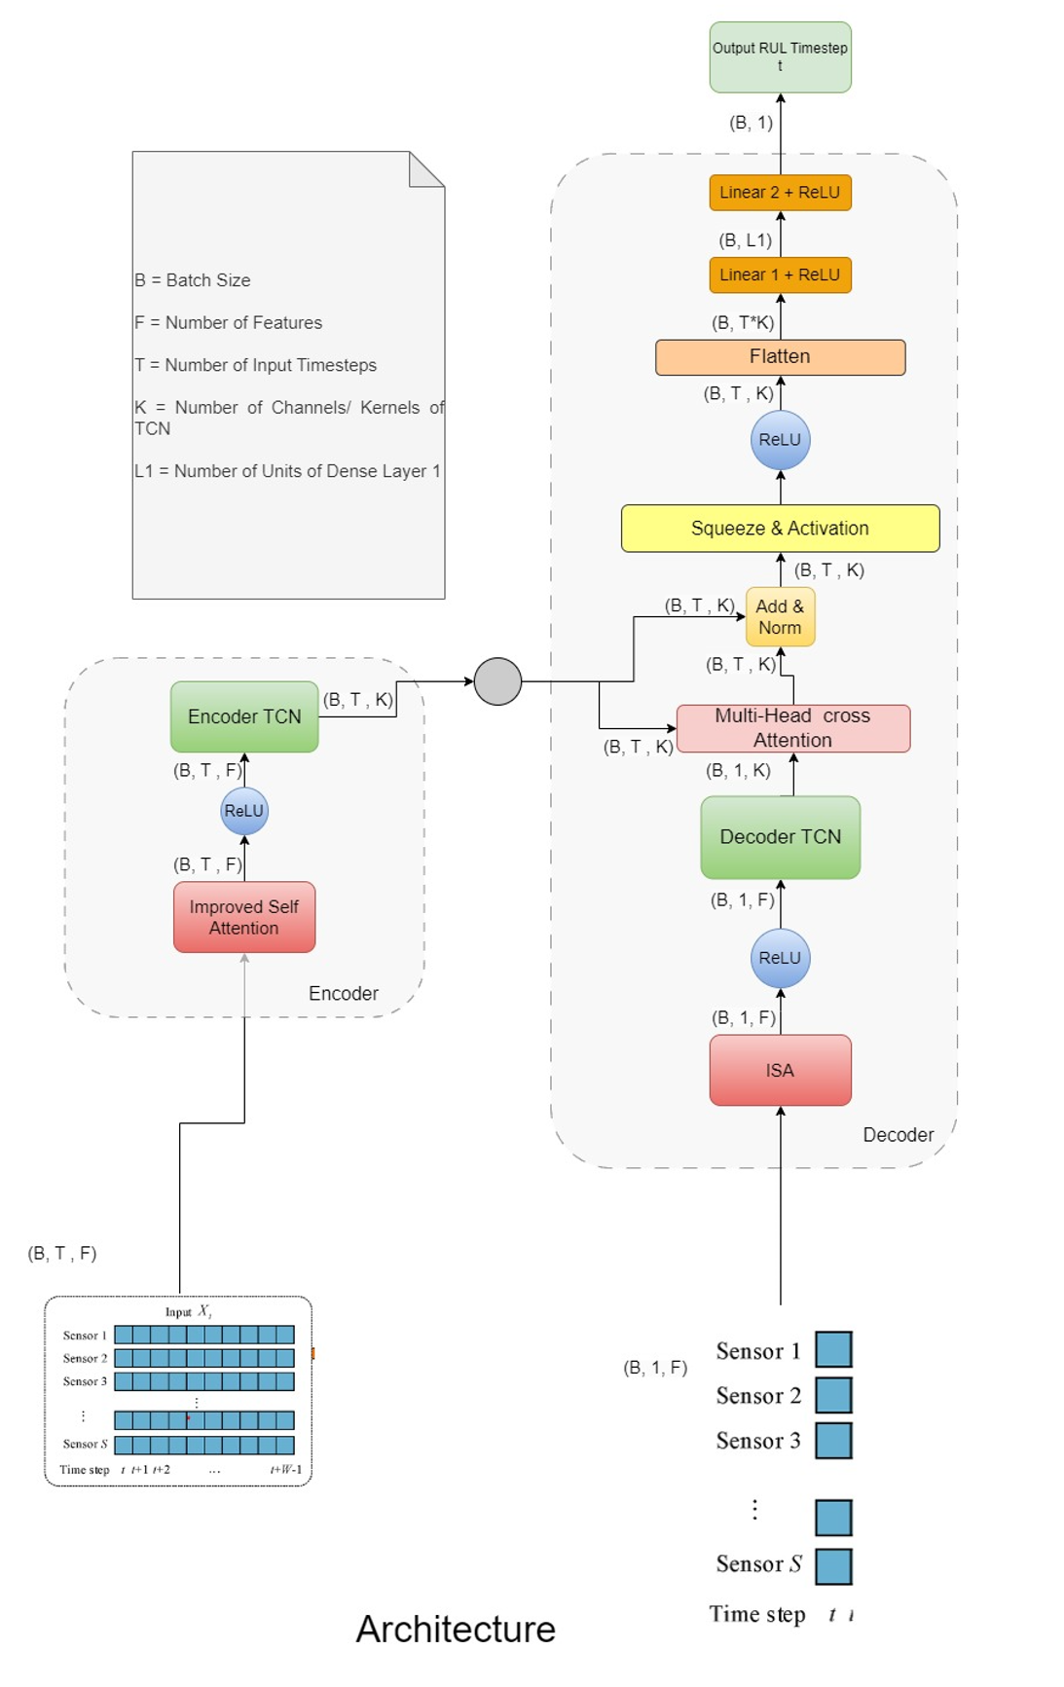
Proposed Model Architecture

Slide 16
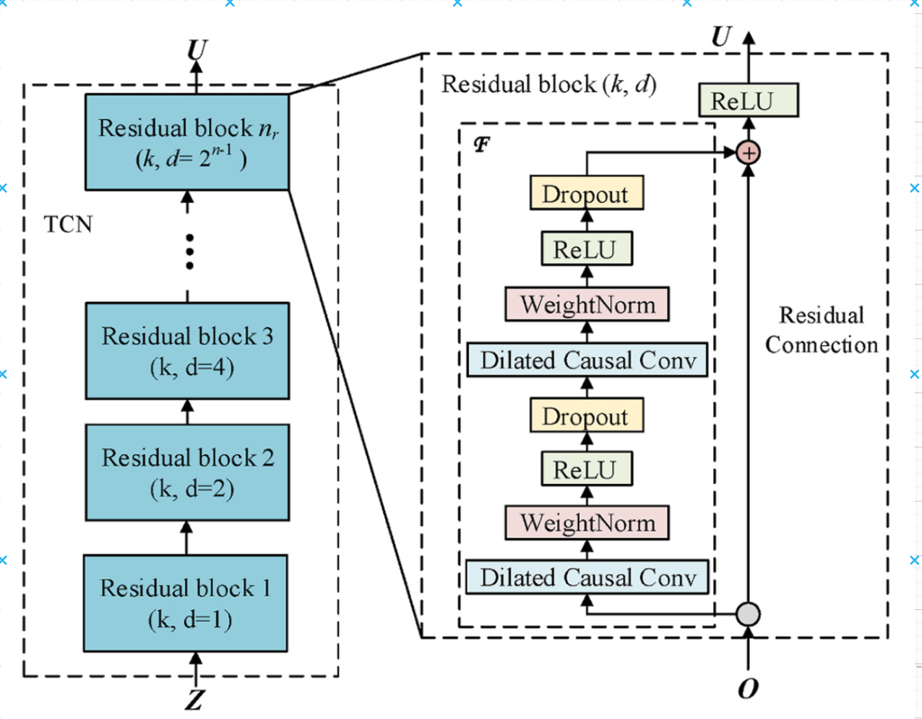
Temporal Convoluted network
One TCN cell (residual block) is structured like this (when choosing ReLu as activation function).
The Residual connection helps in rapid backpropagation process and helps in parallelization. The TCN does not have to depend on the output of the previous timestep for loss propagation unlike LSTMs.

Slide 17
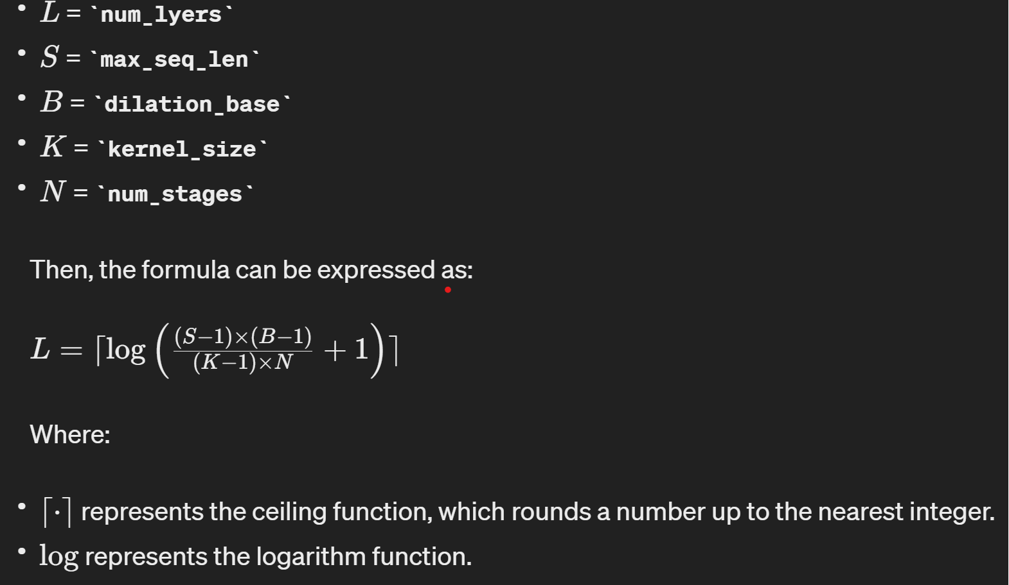
Choosing Number of Residual Blocks L
The TCN blocks use as many layers as needed to get a connection from first time step input to last timestep output i.e the number of layers are determined by the number of timesteps in our training dataset in the following way.

Slide 18
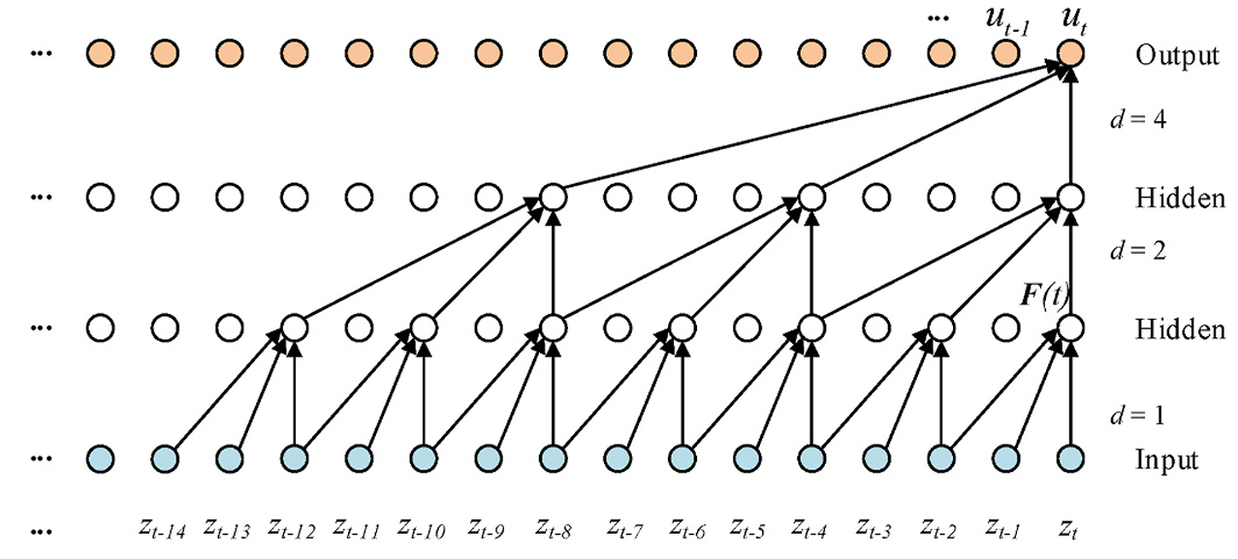
Up Close Dilated Convolutions with Causal Padding
Causal Padding : Output at time t is convolved only with elements from time t and earlier (0 to t-1) in the previous layer. In order to achieve this, zero padding of length (kernel size − 1) is added to keep subsequent layers the same length as previous ones.
Dilated Causal Convolutions: Dilation is equivalent to introducing a fixed step between every two adjacent filter taps. When d = 1, a dilated convolution reduces to a regular convolution. Dilation exponentially increases the receptive field of a TCN.

Slide 19
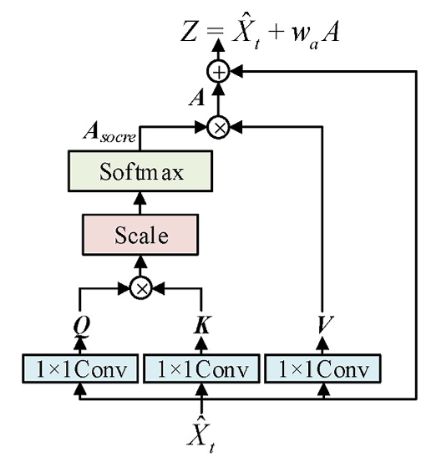
Improved Self Attention Layer
In order to capture contributions of each time step from input features, an improved self-attention mechanism (ISA) is constructed.
The convolution increases the depth of the ISA and introduces nonlinear features to enhance expressiveness of the ISA. Meanwhile, a residual connection structure is introduced to improve the stability of the ISA.

Slide 20
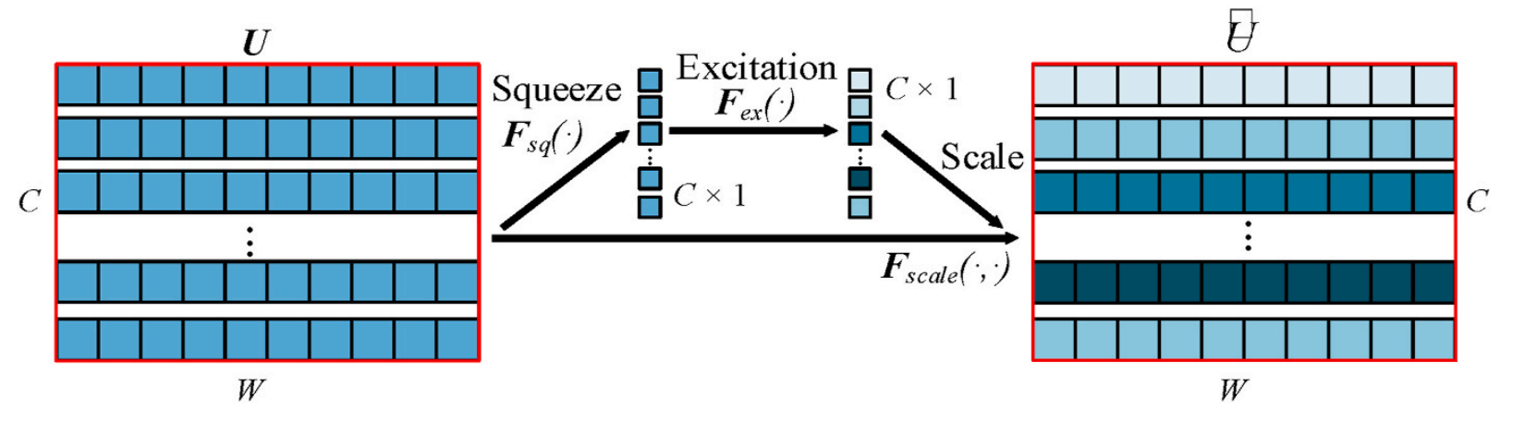
Squeeze And Excitation Layer
Given that input features are multi-channel, and each channel has different contributions to RUL predictions, a squeeze-and-excitation mechanism is adopted to capture contributions from channel-domain features. The SE includes two parts, i.e. squeeze Fsq(⋅) and excitation Fex(⋅).
Fsq(⋅) represents global average pooling for input features. Fex(⋅) denotes attention weights for channels obtained through a gating mechanism.

Slide 21
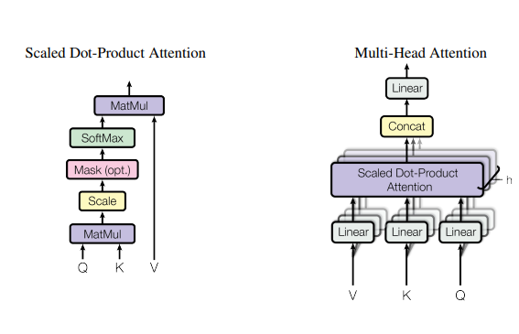


Multi-Head Cross Attention
K - Key
V - Value
Q - Query

Slide 22
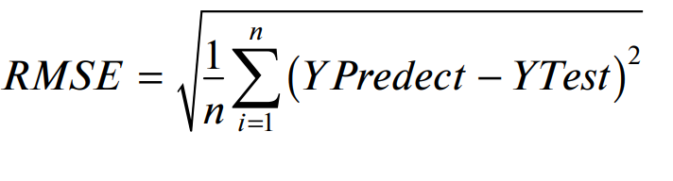
Metrics ( RMSE & Score)
The Root Mean Square Error Loss is used for the training of our model. The Root Mean Square Error (RMSE) is a standard way to measure the error of a model in predicting quantitative data. It represents the square root of the mean squared difference between the predicted values and the observed values.
The best RMSE validation loss for our model was observed to be 44 for this use case.

Slide 23
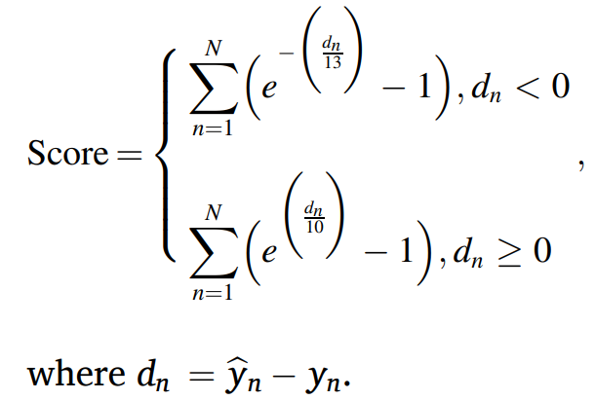
Metrics ( RMSE & Score)
N represents number of samples. n represents the n-th sample. yn and ˆyn represent the actual and estimated RUL for the nth sample respectively.
RMSE treats early and late predictions as equally important, while Score gives large penalties for late predictions. As early predictions might provide sufficient time for preventive maintenance, early predictions for RUL prediction of engines are better than late predictions.

Slide 24
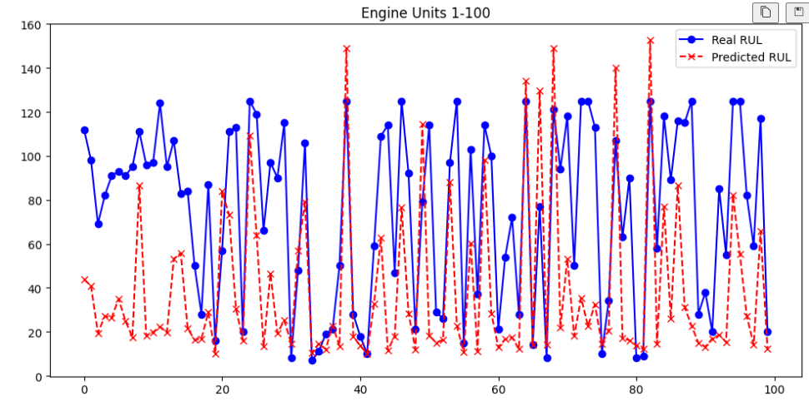

Results
True vs Predicted RUL Values for Test Engines

Slide 25
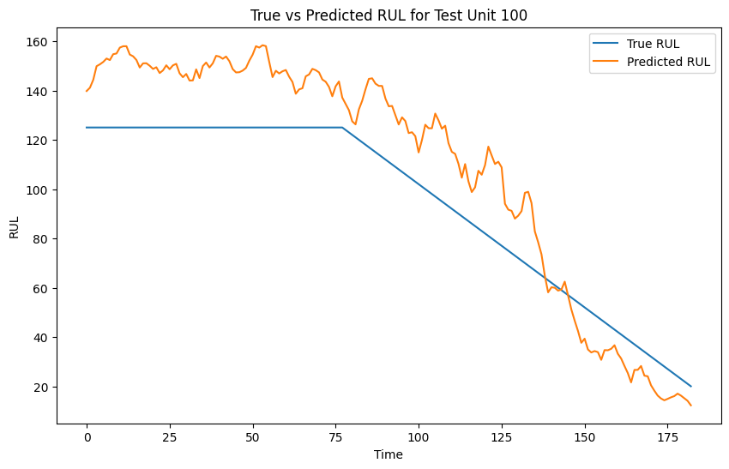
Results ( Individual engine)

Slide 26


